Slide 1





inside
ExFlow
in D365 F&O

Slide 2


eftsure inside ExFlow in D365 F&O
Electronic onboarding,
Automated Invoicing,
Secure Payment :
‘The Blueprint of the future
of AP Departments’
Notes:
https://demo.eftsure.net/?cmp=PNT&mi=EXF_mdExFlowAdminWorkspace
https://demo.eftsure.net/?cmp=PNT&mi=EXF_mdImportTableListPage
https://demo.eftsure.net/?cmp=PNT&mi=EXF_mdDocumentTableListPage

Slide 3
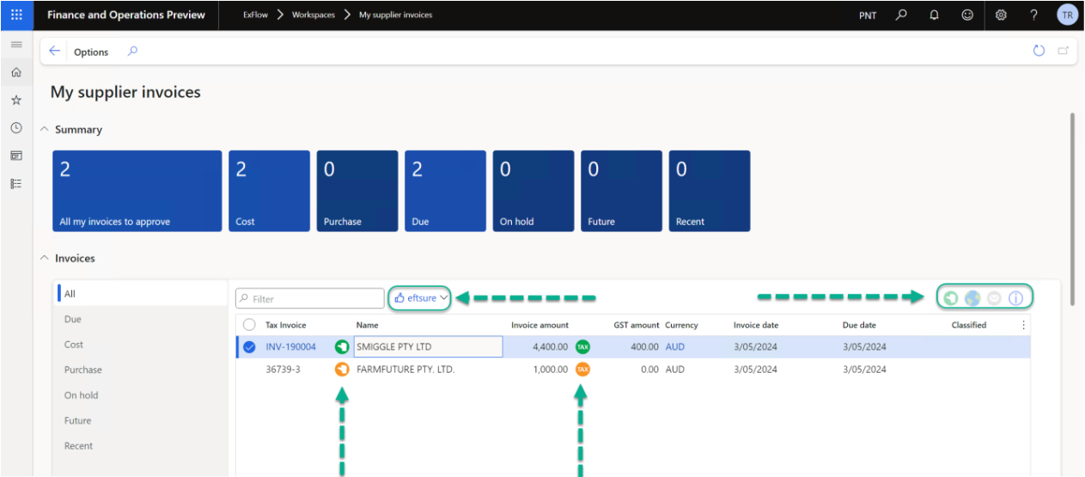
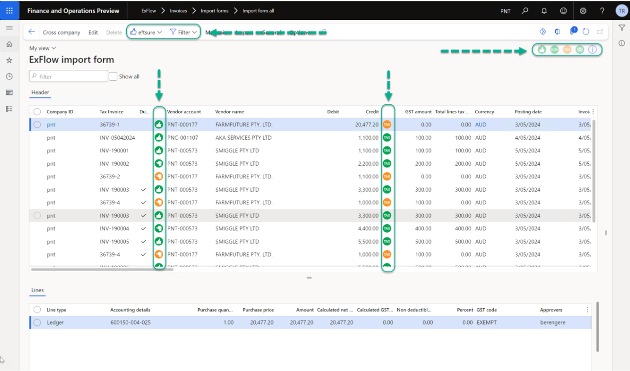
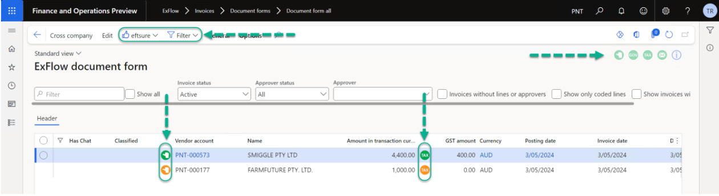
eftsure inside ExFlow

Slide 4
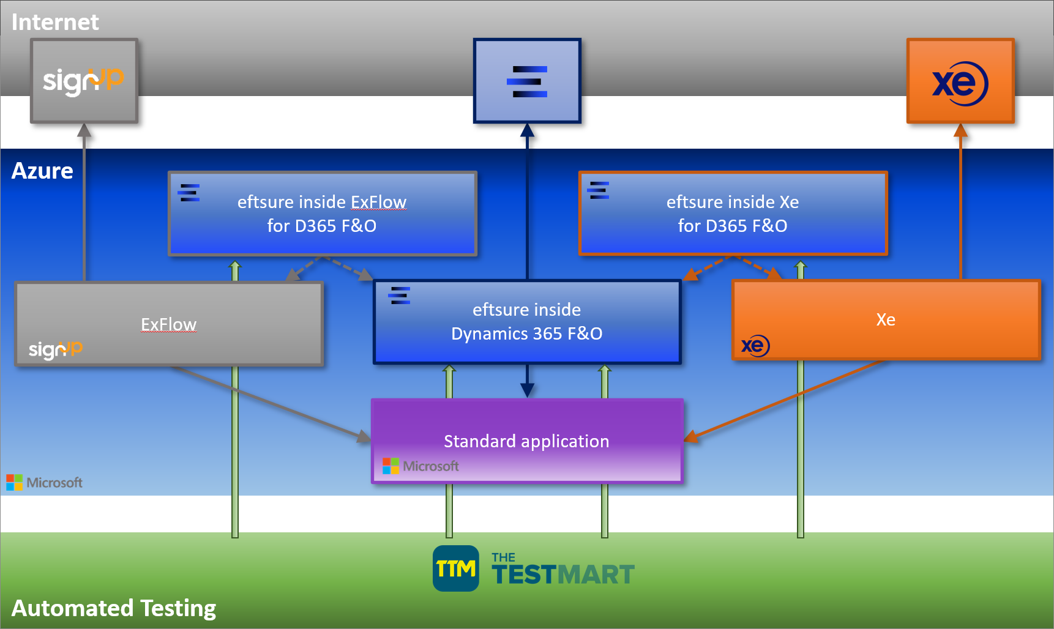
D365 Partnerships
ExFlow FO AP Automation
Accounts Payable and Invoice Process automation for Microsoft Dynamics 365 for Finance and Operation
Xe Global Payments for D365 Finance
Simplify & automate your global vendor payment process with a real-time embedded currency solution

Slide 5
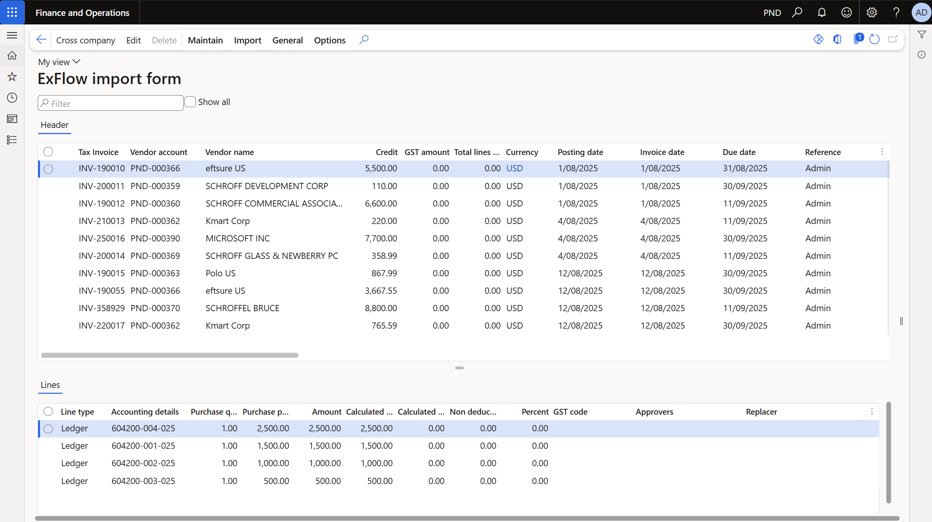
ExFlow alone
Notes:
https://demo.eftsure.net/?cmp=PNT&mi=EXF_mdExFlowAdminWorkspace
https://demo.eftsure.net/?cmp=PNT&mi=EXF_mdImportTableListPage
https://demo.eftsure.net/?cmp=PNT&mi=EXF_mdDocumentTableListPage

Slide 6
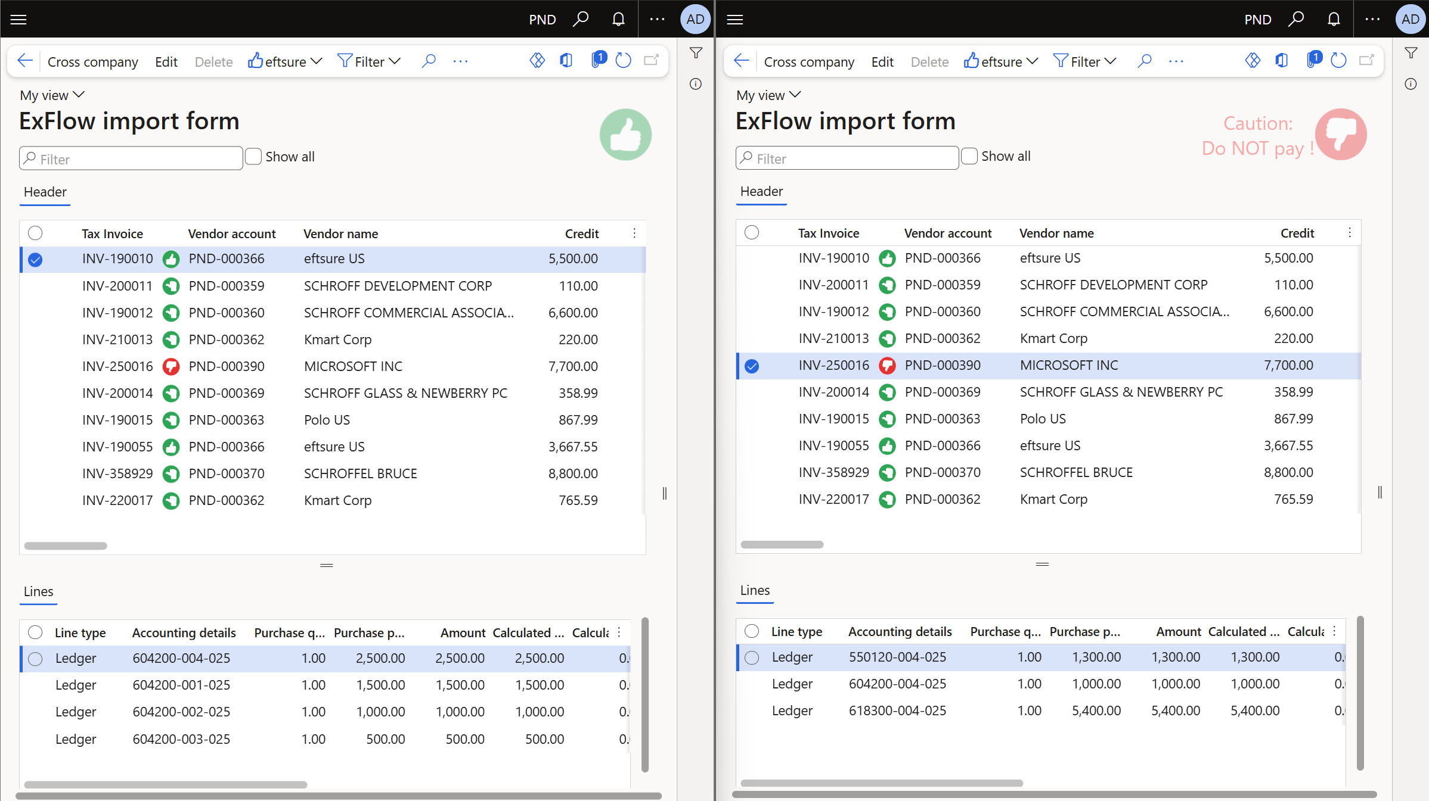
eftsure inside ExFlow in D365 F&O
Notes:
https://demo.eftsure.net/?cmp=PNT&mi=EXF_mdExFlowAdminWorkspace
https://demo.eftsure.net/?cmp=PNT&mi=EXF_mdImportTableListPage
https://demo.eftsure.net/?cmp=PNT&mi=EXF_mdDocumentTableListPage

Slide 7
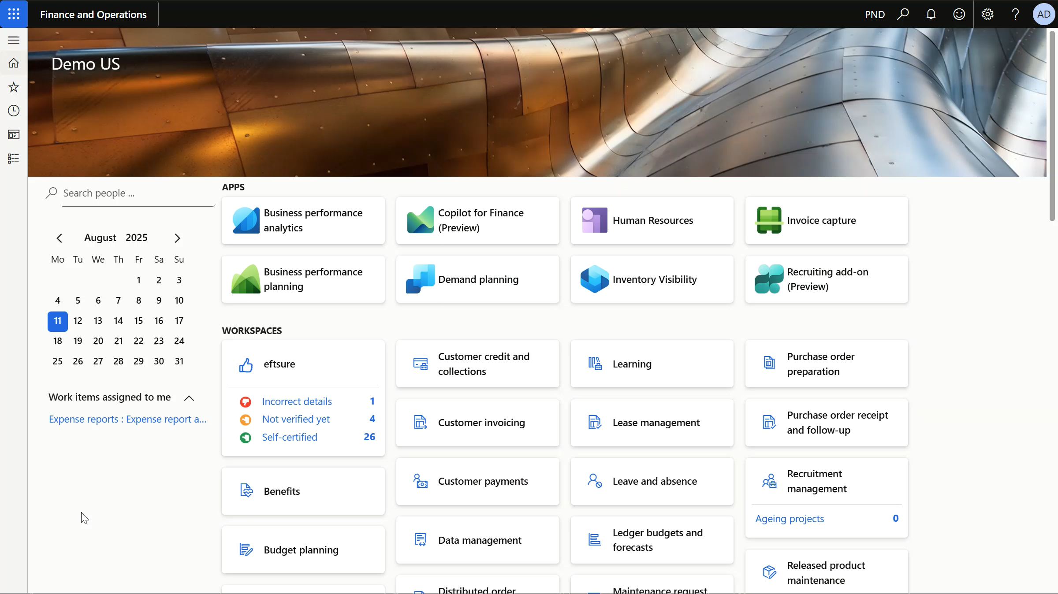
eftsure inside ExFlow in D365 F&O
Notes:
https://demo.eftsure.net/?cmp=PNT&mi=EXF_mdExFlowAdminWorkspace
https://demo.eftsure.net/?cmp=PNT&mi=EXF_mdImportTableListPage
https://demo.eftsure.net/?cmp=PNT&mi=EXF_mdDocumentTableListPage

